Slide 1
Country Level Indicators of Suicide Risk: Data Analysis and Decision-Making Support for Policy Makers
Team 25: ISyE 6414 Spring 2020

Slide 2



Team Members: Team 25
Background Information on Team (add a picture)
Little bit of get to know you
Osman Ghandour
BS in ISyE
From Columbia, SC
Hobbies: Fitness & Podcasts
Samuel Garcia
MS in Statistics
(Part-time - ISyE)
From San Juan, PR
Hobbies: Software Development and Linux
Michael Szostak
MS in Aerospace
Aerospace Systems Design Lab
From Austin, TX
Hobbies: Running & Mtn Biking
Peter Williams
MS in Statistics
(Part-time - School of Math)
From Atlanta, GA
Hobbies: Running & Board Games

Slide 3
Contents
Research Motivation……………………................……………….…..4-13
Data Sources…........……………………………………………….….15-18
Modeling & Assumptions……………………………………………...19-24
Quantifying Impact of Measures on Suicide…….………..………....25-29
Recommendations & Decision Support…………………………..….30-32
Limitations & Future Research……….……………………..……..…33-35
Appendix……………….……………………………………..……..….36-37

Slide 4
Research Motivation

Slide 5
Background and Motivation – Why We Chose This Topic
“I'm the girl nobody knows until she commits suicide. Then suddenly everyone had a class with her.” ― Tom Leveen, Party
Suicide is an international problem, deaths are tragic, also preventable
The possibility of prevention and the scale of the problem highlight the need for policy makers, at the national level, to understand the factors that contribute to suicide not only in their respective countries but also in neighboring countries

Slide 6
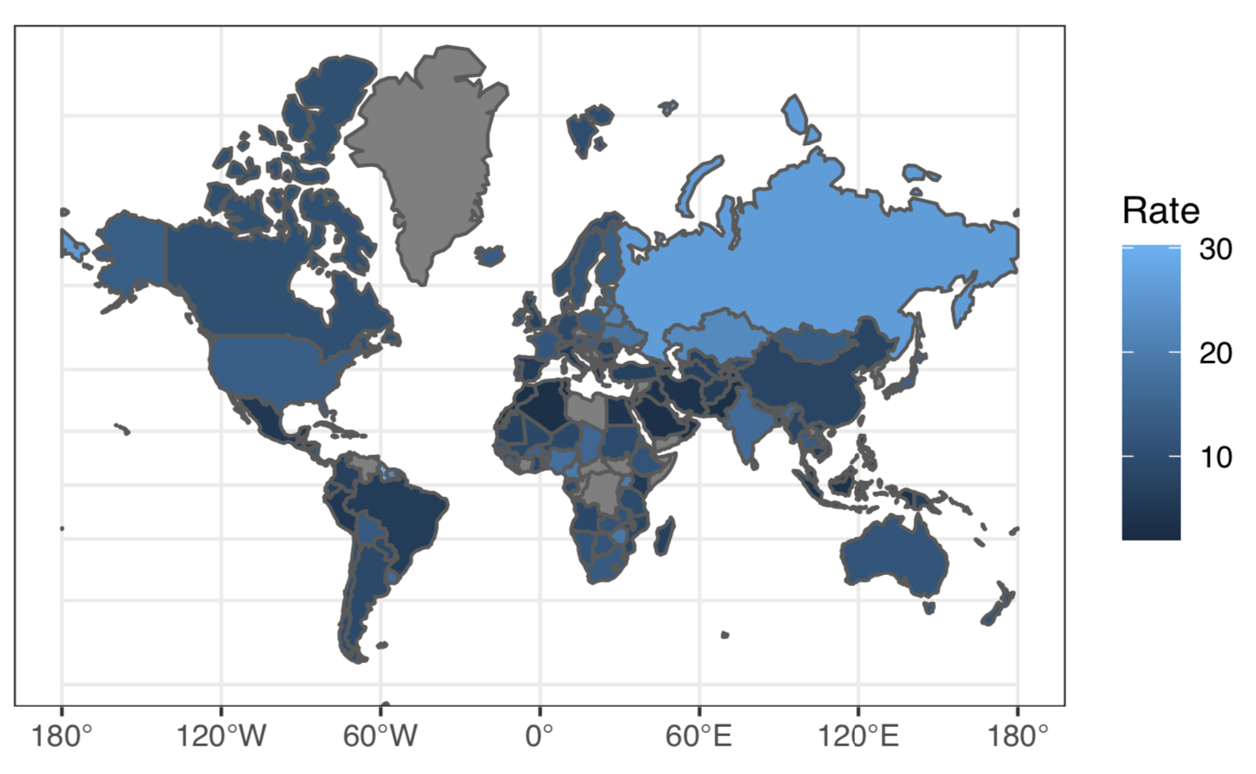
Suicide is a Global Problem With Significant Effects
Worldwide Suicide Rate by Country (per 100,000 persons)
Key Insights*
One person dies every 40 seconds from suicide
Suicide is the 2nd leading cause of death among persons 18-29
Only 38 governments worldwide have a national suicide prevention program
Sadly, many deaths attributed to suicide are preventable
*Sourced from the World Health Organization report: “Suicide: Key Facts, 2019”

Slide 7
Why is suicide a complex problem?
No singular cause: psychological, social, biological, cultural, and environmental dimensions
Not all who commit suicide do so because of mental illness
Stressful experiences, such as exposure to trauma, the death of a loved one, job loss, change in physical health or relationships...are also associated with suicide [2].
Notes:
[1] “Does suicide always indicate a mental illness?”, Sanati, A 2009,
https://www.ncbi.nlm.nih.gov/pmc/articles/PMC4222167/. Accessed 12 Apr. 2020.
[2] “Suicide Prevention Framework”
https://www.canada.ca/en/public-health/services/publications/healthy-living/suicide-prevention-framework.html.
Accessed 12 Apr. 2020

Slide 8
Faltering GDP, Economic Instability & Poverty Contribute to Suicide in Zimbabwe
Africa: Suicide Rate by Country (per 100,000 persons)
Key Insights*
The WHO estimates that 19 persons per 100k take their own life deliberately in Zimbabwe per annum (2019)
Zimbabwe has dealt with issues of endemic poverty, unemployment and hyperinflation for years which is often attributed to the policies of former dictator Robert Mugabe
Post Mugabe, Zimbabwe continues to deal with debt issues, difficulty attracting foreign investment, and currency instability which continue to contribute to systemic unemployment and poverty nationwide
*Sourced from the World Health Organization report: “Suicide: Key Facts, 2019” and the WorldBank Economic Profile of the Country of Zimbabwe

Slide 9
Alcohol Dependence and Abuse May Contribute to Suicide in Russia
Russia: Suicide Rate by Country (per 100,000 persons)
Key Insights*
The WHO estimates that 27 persons per 100k take their own life deliberately in Russia per annum (2019)
Among the general populace in Russia, meaning that almost 1-in-20 adults suffer from alcohol dependence
Alcoholism has been a problem because drinking is not only pervasive, but also a socially acceptable behavior in Russian society
Of the 166 countries in our study, Russia ranks 3rd in the world for suicides per capita.
*Sourced from the World Health Organization report: “Suicide: Key Facts, 2019” and the WorldBank Economic Profile of the Country of Zimbabwe

Slide 10
Scope
Can we identify which measures/indicators are best associated with suicide rates at the country level?
Conscious choice to limit the study to a set of factors, from which to draw inferences, that could be controlled for and acted upon via policy interventions
Considered factors from different domains such as lifestyle, medical/mental health, economic, and suicide-focused policy

Slide 11
Variables and Data Sources

Slide 12
Outcome Variable
Outcome variable : Suicide Rate, per 100,000 population
Data Description: The suicide rate is age-standardized, meaning that it is a weighted average of the age-specific mortality rates per 100 000 persons, where the weights are the proportions of persons in the corresponding age groups of the WHO standard population.
Source: World Health Organization [1] (see appendix for link)

Slide 13
Considered Independent Variables
Health Expenditure and GDP per capita was chosen to reflect the resources that a country has its disposal to reduce the suicide rate
Liters of Alcohol per capita was chosen to account for an aspect of culture (alcohol consumption) that the media often links to mental health outcomes
The prevalence of a suicide prevention strategy, the number of psychiatrists, and the number of mental hospitals were chosen to reflect how a country has deployed its resources to improve mental health outcomes
The female/male labor participation ratio was included to control for this aspect of a country’s culture

Slide 14
Data Sources
Input | Data Description | Source
Current Health Expenditure as a Percentage of GDP | This data provides an indication on the level of resources channeled to health relative to other uses. It shows the importance of the health sector in the whole economy and indicates the societal priority which health is given measured in monetary terms. | World Health Organization [2]
Labor force participation rate (female-male ratio) | Ratio of female to male of proportion of a country’s working-age population (ages 15 and older) that engages in the labor market, either by working or actively looking for work, expressed as a percentage of the working-age population. | United Nations Development Programme [1]
GDP per capita, PPP | Gross Domestic Product converted to international dollars using purchasing power parity (PPP) rates and divided by total population. This data is in terms of PPP in order to account for differences in the cost of living between countries. | World Bank [1]
Liters of Alcohol per capita | Total (sum of recorded and unrecorded alcohol) amount of alcohol consumed per person (15 years of age or older) over a calendar year, in litres of pure alcohol, adjusted for tourist consumption. | World Bank [2]
Suicide Prevention Strategy | Countries which are known have a stand-alone national suicide prevention strategy are included as 1s, else 0. Note that the plan must be stand-alone, and may not be integrated into another plan, in order to count in the dataset. | World Health Organization [3]
Psychiatrists in mental health, per 100,000 pop. | Number of Psychiatrists working in the mental health sector, per 100,000 population. | World Health Organization [4]
Mental hospitals, per 100,000 pop. | Number of hospitals dedicated to mental health per 100,000 population | World Health Organization [5]
Notes:
[x1] https://www.who.int/data/gho/data/indicators/indicator-details/GHO/current-health-expenditure-(che)-as-percentage-of-gross-domestic-product-(gdp)-(-)
[x6] https://www.who.int/gho/mental_health/human_resources/psychiatrists_nurses/en/

Slide 15
Modeling & Assumptions

Slide 16
Modeling Objective: Inferential vs Predictive
Our model is intended to be used for inferential, rather than predictive, purposes
The model was developed to infer properties about how a handful of socioeconomic and cultural indicators impact suicide rates
Our objective is to discover relationships between variables to inform relevant public policy and future research in the area

Slide 17
Approach to Modeling: Development Steps
Transformation on Outcome Variable
Box Cox
Removal of Outliers
Diagnostic Plots
Variable Selection
Step-AIC
Final Model
Iteratively Weighted Least Squares

Slide 18
Variable Decisions
Selected & Included
Considered & excluded
Labor force participation rate (female-male ratio)
GDP per capita, PPP
Liters of Alcohol consumption per capita
Prevalence of a Suicide Prevention Strategy
Current Health Expenditure as a Percentage of GDP
Number of Psychiatrists working in the mental health sector, per 100,000 population
Number of Mental Hospitals, per 100,000 population

Slide 19
Modeling Assumptions
GDP per capita is an appropriate indicator to reflect the wealth of a country
The prevalence of a national suicide prevention strategy is indicative that the country has taken the time to develop a comprehensive and data driven approach to suicide, based on solid evidence
Liters of Alcohol consumed per capita reflects the tendency for individuals in the given country to consume excessive amounts of alcohol

Slide 20
Quantifying the Impact of Measures on Suicide

Slide 21
Identifying, Describing and Monitoring Country Level Indicators Is Critical for Effective Decision-Making Support
Providing Decision Support for Policy Makers
Topline
Using a model to describe the relationships between country-level indicators and suicide rates can help quantify the impact of measures
This allows policy makers to correlate indicators with country-level suicide related outcomes
Our intention is to provide some initial context and decision support for policy makers managing health related planning activities
Identifying & Quantifying Measures and Indicators of Country Level Suicide Rates
Incorporating Domain Knowledge and Expertise of Subject Matter Experts
Data, and Insight Driven Feedback & Monitoring
Insight Gathering, Analysis and Support Policy Maker Decisions

Slide 22
Income, GDP per person: Quantifying Impact & Monitoring
Income vs. Expected Suicide Rate (per 100k Population)
Insights
Our model indicates the presence of a significant relationship between a measure of income (country-level GDP per person) and suicide
Countries with lower per person income, tend to have higher incidence of suicide when controlling for other variables in our model*
Based on our estimates, an approximate 10% increase in income corresponds to a 2% decrease in suicide rate at the country level for the typical country
Note: Expected country level suicide rate, with 95% confidence interval.
*Other variables controlled for include Liters of Alcohol Consumption, The Presence of a National Suicide Strategy Prevention Program, and the Female/Male Labor Participation Rate.

Slide 23
Alcohol Consumption: Quantifying Impact & Monitoring
Alcohol Consumption vs. Expected Suicide Rate
(per 100k Population)
Insights
Our model indicates the presence of a significant relationship between a measure of alcohol consumption (liters per year)
Countries with higher levels of alcohol consumption income, tend to have higher incidence of suicide when controlling for other variables in our model*
Based on our estimates, an approximate 4% increase in alcohol consumption corresponds to a 2% increase in suicide rate at the country level for the typical country (>4 liters per year)
Alcohol consumption was the most impactful and significant indicator of country-level suicide rate in our analysis
Note: Expected country level suicide rate, with 95% confidence interval.
*Other variables controlled for include Income (GDP per person), The Presence of a National Suicide Strategy Prevention Program, and the Female/Male Labor Participation Rate.

Slide 24
The Presence of A National Suicide Strategy: Quantifying Impact & Monitoring
National Suicide Strategy vs. Expected Suicide Rate (per 100k Population)
Insights
Our model indicates that countries that have put a national suicide prevention strategy in place, tend to have higher incidence of suicide rates overall
Based on our estimates, countries that have implemented a suicide prevention strategy have a 26% higher incidence of suicide nationally
However, to put this in context, it appears that the institution of a suicide prevention strategy by countries struggling with suicide prevention overall, including Guyana, Lithuania, Suriname, Belarus and South Korea are driving this estimate
Note: Expected country level suicide rate, with 95% confidence interval.
*Other variables controlled for include Income (GDP per person), Liters of Alcohol Consumed, and the Female/Male Labor Participation Rate.

Slide 25
Recommendations & Decision Support

Slide 26
Recommendation: Implement Ongoing Measurement of Key Indicators
Identify Measures & Indicators
Our initial analysis indicates the presence of significant relationships that describe suicide at the country level
Implement Strategies to Quantify and Monitor
In order to support decision makers, we recommend policy markers collect data and monitor these identified indicators
Inform Policy Making Decisions
Insights provided by the measures highlighted in this analysis are only one facet of an informed policy decision making strategy
We recommend ongoing engagements between health, policy and data experts and to support building a holistic suicide prevention strategy
Income (GDP per person), Alcohol and substance abuse, as well as the presence of a national suicide strategy should be considered in context of policy decision making and support
We recommend engaging subject matter experts as data monitoring and measurement processes are developed

Slide 27
Recommendation: Inform Policy Across These Areas of Focus
Suicide Prevention Strategy
Establish an agency, tasked with implementing a National Suicide Prevention Strategy which doesn't replace local government frameworks
Implement Policies to Mitigate Alcohol Abuse
Increase the price of alcohol via taxation
Invest in Research to Uncover More About The Relationship Between Income and Suicide
Invest in research to better understand potential relationships between income instability, income protection and suicide at the individual level
Follow UN recommendations, and emulate successful policies of other countries
Take advantage of online resources like MiNDbank [1]
Enact and enforce restrictions on alcohol advertising (across multiple types of media)
Enact and enforce restrictions on the physical availability of retailed alcohol (via reduced hours of sale)
Pursue measures aimed at poverty reduction and unemployment benefits to support economic well-being
Notes:
[1] https://www.who.int/mental_health/mindbank/en/

Slide 28
Limitations & Future Research

Slide 29
Limitations
Data
GDP per Capita: meant as a proxy for individual income, use Purchasing Power Parity or Median Income instead
Liters Alcohol Consumed: doesn't consider illicit alcohol, assumes uniform consumption, median consumption preferred
Suicide Policy (NSPS): effectiveness of organizational response hard to gauge since local response vs federal not accounted for
Methodology
Country Level Scope: cannot drill down to local or individual level
Inputs: sources limited to countries which published suicide statistics
Could consider more factors which may influence suicide
Conclusions
Causes may be local/cultural/interactional, difficult to make country-specific inferences

Slide 30
Limitations
Combine with the next slide
GDP per Capita: meant as a proxy for individual income
Next time use Purchasing Power Parity, and or Median Income
Hard to recommend policy action on data sources which averages
Liters Alcohol Consumed: representative of vice of populace
Doesn't consider black market / home fermented alcohol, assumes uniform consumption by populace, median consumption preferred
Other factors to consider: Substance use per country (Heroin, Meth, etc.)
Suicide Policy (NSPS): Organizational response
Effectiveness of implementation per country hard to gage, as only Boolean representation, local response vs federal not accounted for
Acceptance of suicide at national level and policy effects confounded

Slide 31
Limitations Methodology
Combine with the prev slide
Country Level Scope:
Cannot drill down to local, let alone individual level
Chosen Inputs:
Didn't consider all factors which may influence suicide
Data sources limited to which countries published suicide statistics
Outlier countries (I.e. Japan) hard to determine what is different w/ limited set of inputs
Conclusions:
Can't make country specific inferences, this is a global issue, but causes may be local / cultural / interactional

Slide 32
Appendix

Slide 33
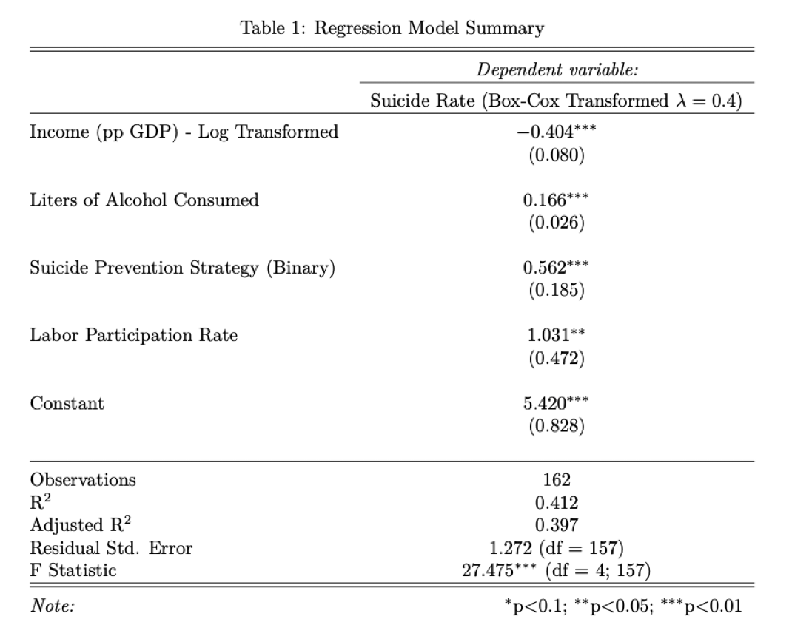
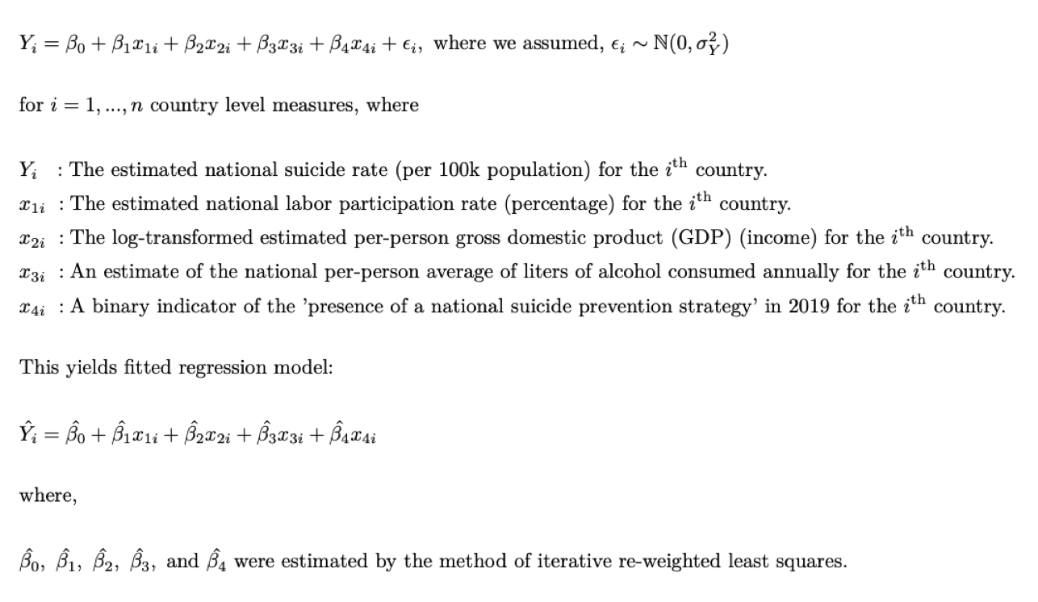
Final Model Specification & Model Results Summary
Final Model Specification
Model Estimates & Results

Slide 34
Sources
World Health Organization [1] : https://apps.who.int/gho/data/node.main.MHSUICIDEASDR?lang=en
World Health Organization [2] : https://www.who.int/data/gho/data/indicators/indicator-details/GHO/current-health-expenditure-(che)-as-percentage-of-gross-domestic-product-(gdp)-(-)
World Health Organization [3] : https://apps.who.int/iris/handle/10665/279765
World Health Organization [4] https://apps.who.int/gho/data/node.main.MHHR?lang=en
World Health Organization [5] : https://apps.who.int/gho/data/node.main.MHFAC?lang=en
United Nations Development Programme [1] : http://hdr.undp.org/en/content/labour-force-participation-rate-female-male-ratio
World Bank [1] : https://data.worldbank.org/indicator/NY.GDP.PCAP.PP.CD
World Bank [2] : https://data.worldbank.org/indicator/SH.ALC.PCAP.LI

Slide 35
Anecdotal evidence about Russia, alcohol, and suicide
“Russian levels of alcohol consumption and suicide are among the highest in the world.” [1] – Pridemore, WA. Heavy drinking and Suicide in Russia.
“…heavy alcohol consumption was promoted as a way to eliminate dissent, while other observers claim that alcohol was — and remains for many — the only escape from the drabness of everyday life.” [2] – Chelala, C. Vodka is Putin’s worst enemy, The Moscow Times
“Russian drinkers die a variety of deaths. Alcohol poisoning. Cirrhosis. Accidents. Suicide…The result? Russians live some of the shortest lives in any large economy.” [3] – Phillips, M. Russia is quite literally drinking itself to death, Quartz
Notes:
[1] Pridemore WA. “Heavy drinking and Suicide in Russia”. Soc Forces. 2006;85:413–30.
https://www.ncbi.nlm.nih.gov/pmc/articles/PMC1642767/. Accessed 11 Apr. 2020.
[2] Chelala C. “Vodka is Putin’s worst enemy” 10 Nov. 2014,
https://www.themoscowtimes.com/2014/11/10/vodka-is-putins-worst-enemy-a41180. Accessed 11 Apr. 2020
[3] Phillips, M. “Russia is quite literally drinking itself to death” 13 May. 2015,
https://qz.com/403307/russia-is-quite-literally-drinking-itself-to-death/. Accessed 11 Apr. 2020

Slide 36
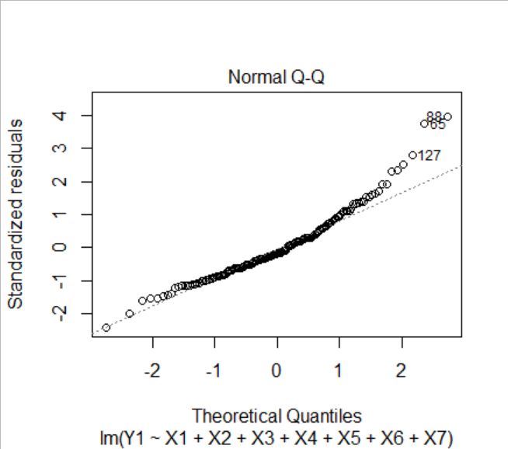

Model Development Initial Model: Multiple Linear Regression
$Y\sim X_{1}+X_{2}+X_{3}+X_{4}$+ $X_{5} {+ X}_{6}+X_{7}$
Normal Q-Q plot shows that the points deviate from the reference line at the higher quintiles. In order to correct for this, our next step was to try a Box Cox transformation on Y.

Slide 37
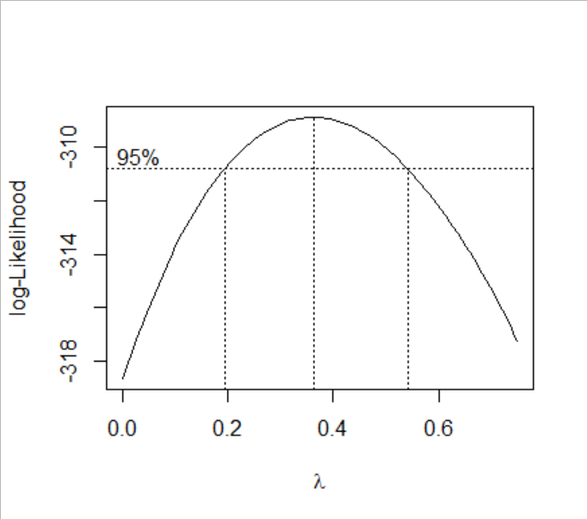
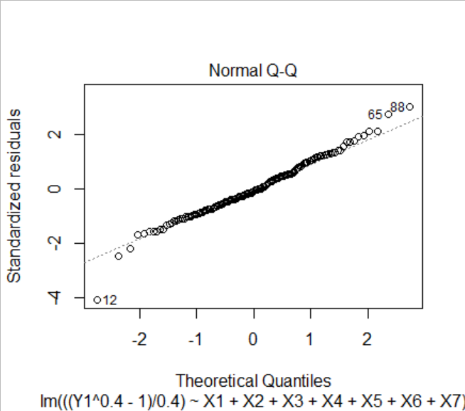

Model Development – Box Cox Transformation
$\frac{Y^{.4}−1}{.4} \sim X_{1}+X_{2}+X_{3}+X_{4}$+ $X_{5} {+ X}_{6}+X_{7}$
Box Cox transformation on λ = 0.4 seems to be appropriate
After transformation, the points in the Normal Q-Q plot are much closer to the reference line

Slide 38
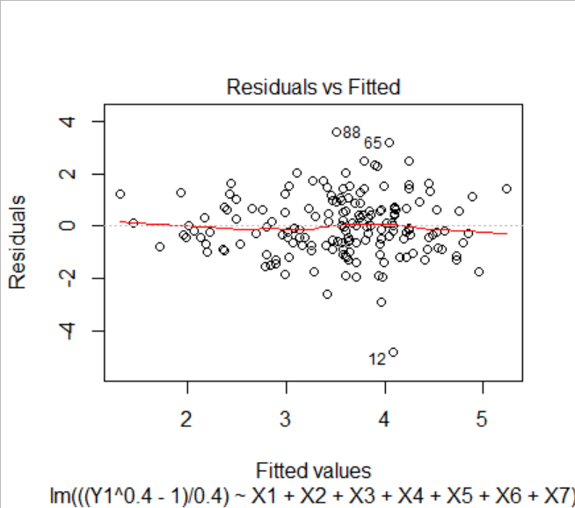
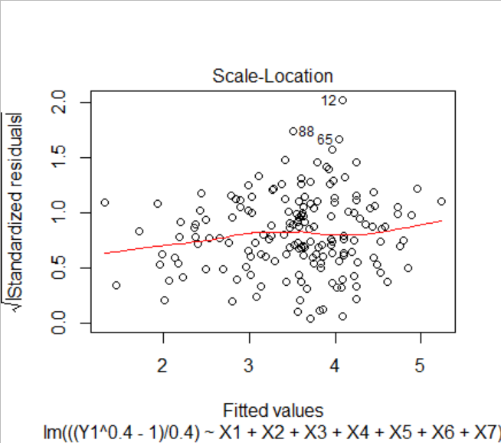
Model Development – Remove Outliers
Points 12, 65, and 88 were identified as outliers on the Residuals vs Fitted, Scale-Location, and Normal Q-Q plots (refer to previous slide)

Slide 39
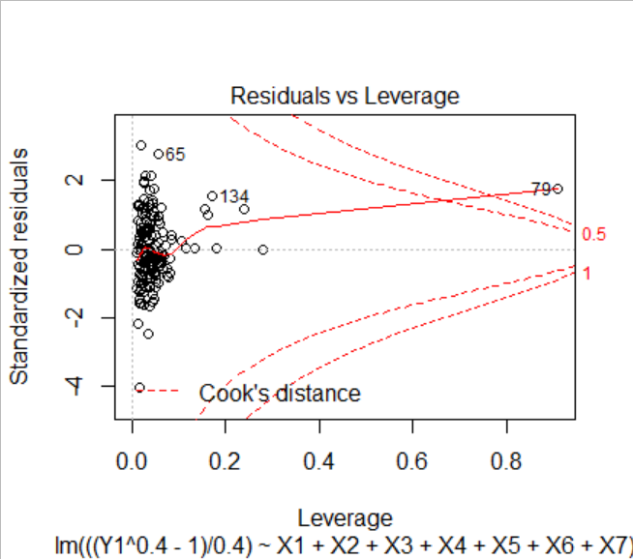
Model Development – Remove Outliers
In addition, point 79 was identified as an outlier that should be removed, as it had very high leverage in the model

Slide 40
Model Development – Remove Outliers
Points 12, 65, 79, and 88 also had country specific reasons for being removed from the data set
12 – Barbados:
Caribbean's leading tourism island, transitioned from agricultural to service based economy very successfully
“very high human development‟ status in terms of the UNDP’s human development index
Extremely low suicide rate
65 – Guyana:
Extremely poor island country largely made up of agricultural villages.
Very high alcohol and suicide statistics
Ministry of health identified poverty, pervasive stigma about mental illness, access to lethal chemicals, alcohol misuse, interpersonal violence, family dysfunction and insufficient mental health resources as key factors causing one of the highest suicide rates in the world.
79 – Japan:
Notoriously overworked and over stressed population, although the country is very wealthy
Long cultural history of considering certain types of suicides honorable, relatively high cultural tolerance for suicide
Very high suicide rate when compared to other rich nations
88 – Lesotho:
Small, landlocked, mountainous country in Africa
Highest suicide rate in Africa
High levels of child labor
Very poor general health outcomes, ex. second highest instances of tuberculosis and HIV/AIDS in the world

Slide 41

Model Development – Variable Reduction
Next step was to remove the variables that were redundant or unnecessary in our model. We used the step function which removes variables based on AIC.
Removed Variables:
X1 – Health Expenditure as a percentage of GDP
X6 – Psychiatrists working in mental health sector (per 100 000 population)
X7 – Mental hospitals (per 100 000 population)
Model After Variable Reduction: $\frac{Y^{.4}−1}{.4} \sim X_{2}+X_{3}+X_{4}$+ $X_{5}$

Slide 42
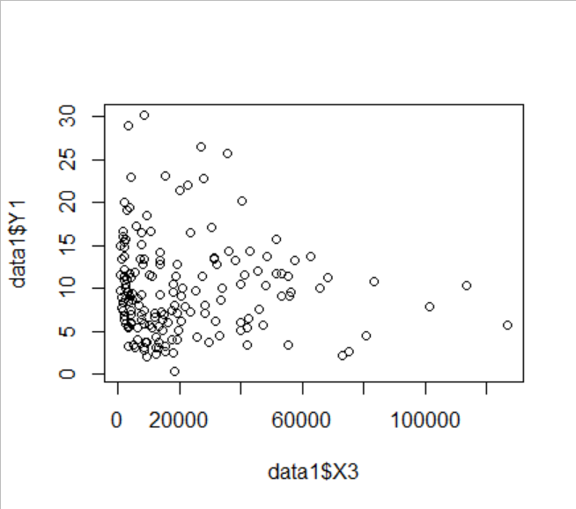
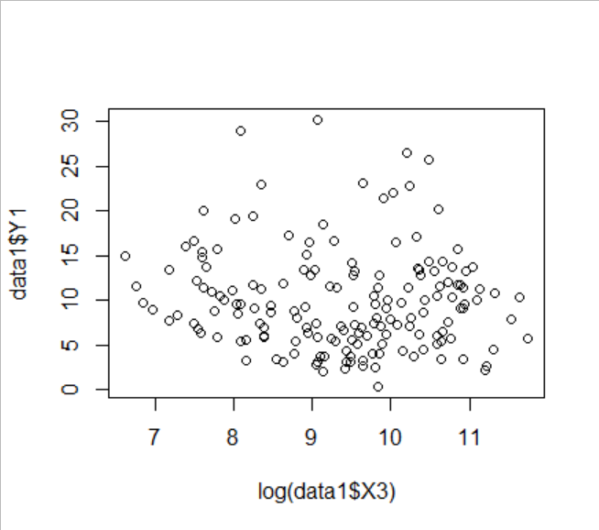

Model Development – Predictor Transformation
After removal of variables based, further analysis was performed to decide whether a predictor transformation may be appropriate.
We discovered that a log transformation of GDP per capita (X3) would better represent the relationship between this predictor and the outcome variable
Before transformation
After transformation
Model After Predictor Transformation: $\frac{Y^{.4}−1}{.4} \sim X_{2}+{log⁡(X}_{3})+X_{4}$+ $X_{5}$

Slide 43
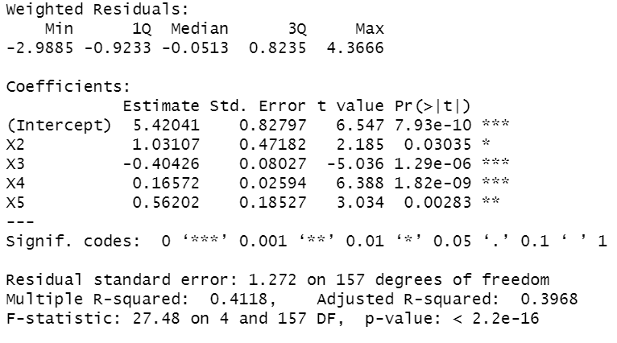
Model Development – IWLS and Final Model
Final step was to implement iteratively weighted least squares
Performed 10 iterations
To the right is the summary of the final model after IWLS

Slide 44
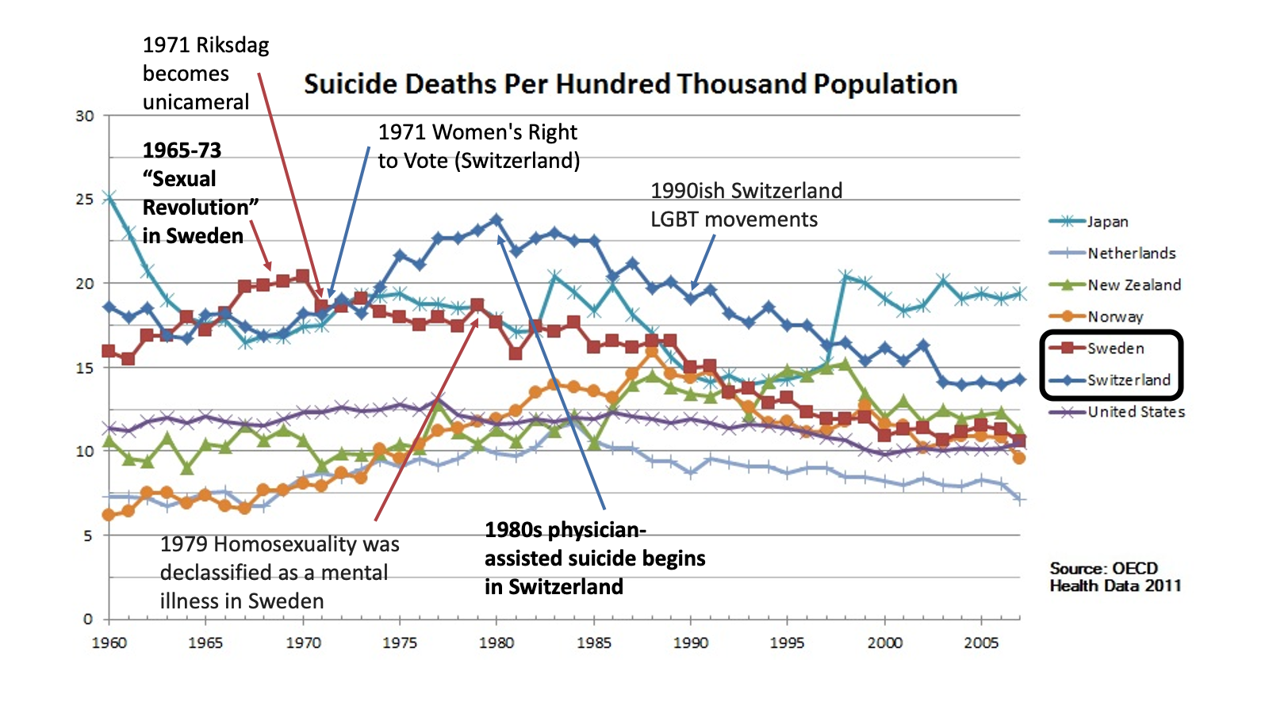
Historic Perspective

Slide 45
Suicide is nuanced, see the graph on the next slide which show historical rates suicide rates of different countries [4][5][6][7].
When we look specifically at the Sweden and Switzerland’s rates
both fall in ~1972 and 1981 respectively.
By comparing historical events of each country some interesting hypotheses can be drawn.
Governmental changes coinciding in 1971 for both countries did not dramatically improve the rate.
Cultural events which affected how masses might view a social issue had much greater temporal impacts on their rates.
Euthanasia in the 1980s Switzerland coincided with an inversion of the curve of its rate. The cultural perception of suicide as a “bad” thing became more accepted in certain circumstances and may have translated to individual self-perceptions of suicidal thoughts to be a more normal occurrence which would not be cause for social abandonment.
Sweden’s “Sexual Revolution” translated to an acceptance of a group, LGBT identifying individuals, which today has been identified as an at-risk population.
While government implementation of NSPSs may lead to a reduction in suicide, it may also be the cultural recognition of the issue, in addition to specific policy actions which decrease overall suicide.
Notes:
[4] https://en.wikipedia.org/wiki/Suicide_in_Switzerland
[5] https://en.wikipedia.org/wiki/Switzerland
[6] https://en.wikipedia.org/wiki/Sweden
[7] https://en.wikipedia.org/wiki/Riksdag

Slide 46

Remaining Inputs: Health Expenditure
Current Health Expenditure as % of GDP
Data retrieved from the WHO gathered from Civil Registration records [1]
CHE is based on expenditures “including healthcare goods and services consumed during each year. This indicator does not include capital health expenditures such as buildings, machinery, IT and stocks of vaccines for emergency or outbreaks.” [2].
In 2015 CHE was 10% globally [3], and is typically higher for devolved countries
Studies in the past have seen a negative correlation between CHE and suicide rates [4]
Notes:
[1] https://www.who.int/health_financing/topics/resource-tracking/ghed-update/en/
[2] https://datacatalog.worldbank.org/current-health-expenditure-gdp
[3] https://www.who.int/gho/health_financing/health_expenditure/en/
[4] https://journals.sagepub.com/doi/pdf/10.1177/070674371005500406

Slide 47

Remaining Inputs: NSPS
Countries which have a National Suicide Prevention Strategy (NSPS)
Data retrieved from the UN report gathered from participating countries [1]
An implementation of a NSPS in Scotland called “Choose Live” decreased suicide rates by 20% over 10 years. [1].
Since a WHO report on suicide prevention, the WHO has tracked a growing number of technical requests from countries on how to implement NSPSs. [1]
While government implementation of NSPSs may lead to a reduction in suicide, it may also be the cultural recognition of the issue by government, in addition to specific policy actions which decrease overall suicide.
Notes:
[1] https://apps.who.int/iris/rest/bitstreams/1174021/retrieve

Slide 48
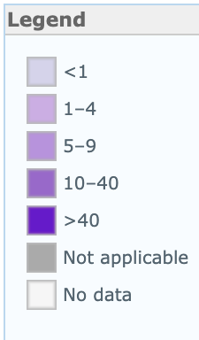
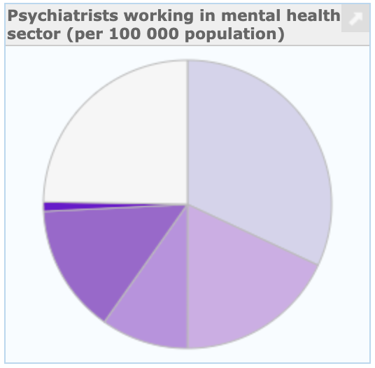
Remaining Inputs: Psychiatrists
Psychiatrists Working in Mental Health Sector (per 1000000 population)
A Psychiatrist is a practitioner of psychiatry, the branch of medicine devoted to the diagnosis, prevention, study, and treatment of mental disorders [1].
Low-income countries have 0.1 psychiatrists and the rate of psychiatrists in high income countries is 120 times greater [1]

Slide 49
Remaining Input: Alcohol Consumption
Liters of Pure Alcohol Consumed per Capita per Year
Data gathered from World Health Organization’s (WHO) Substance Abuse Country Profiles (Is this correct?)
Harmful use of alcohol is among the major risk factors for suicide
The harmful use of alcohol is defined as “…drinking that causes detrimental health and social consequences for the drinker, the people around the drinker and society at large…” [1]
Risk of suicidal ideation, suicidal attempts and completed suicide are each increased by 2–3 times among those with Alcohol Use Disorders (AUD) in comparison with the general population [2]
People have approximately seven times increased risk for a suicide attempt soon after drinking alcohol, and this risk further increases to 37 times after heavy use of alcohol [3]
Notes:
[1] "WHO | Global status report on alcohol and health 2018 - World ...." 21 Sep. 2018,
https://www.who.int/substance_abuse/publications/global_alcohol_report/en/. Accessed 5 Apr. 2020.
[2] "Alcohol-Related Risk of Suicidal Ideation, Suicide Attempt ...." 20 May. 2015,
https://www.ncbi.nlm.nih.gov/pmc/articles/PMC4439031/. Accessed 5 Apr. 2020.
[3] "A meta-analysis of acute use of alcohol and the risk of suicide ...." 8 Dec. 2016,
https://www.ncbi.nlm.nih.gov/pmc/articles/PMC5340592/. Accessed 5 Apr. 2020.

Slide 50
Remaining Input: Alcohol Consumption
Countries that have higher rates of alcohol use generally also have higher rates of suicide, and we were able to draw similar conclusions from our findings
A study published in The Lancet found that global alcohol consumption saw an increase of about 70% from 1990 to 2017 [1]
Notes:
[1] “Where Global Alcohol Consumption Is Rising and Falling”,
https://www.forbes.com/sites/niallmccarthy/2019/05/09/where-global-alcohol-consumption-is-rising-falling-infographic. Accessed 6 Apr. 2020.

